Slide 1

Recommender system
Team 6

Slide 2
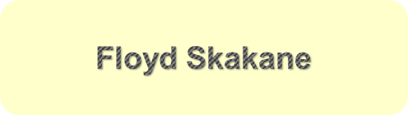
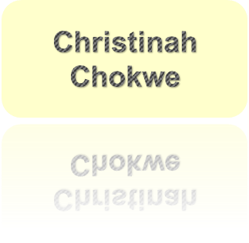
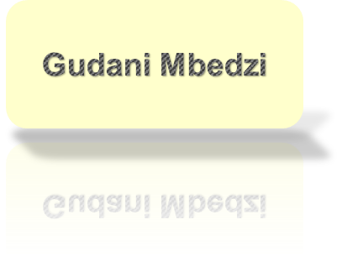
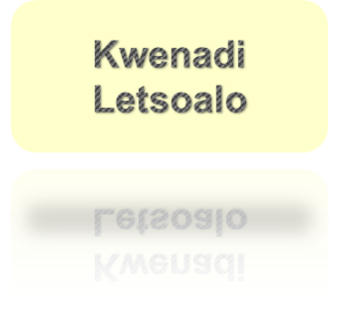
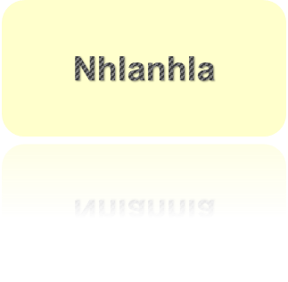
Team members

Slide 3
1. Introduction
5. Model Building
2. Problem Statement
6. Model deployment
3. Project sequence
7. References
4. Explanatory Data Analysis
8. Acknowledgements

Slide 4
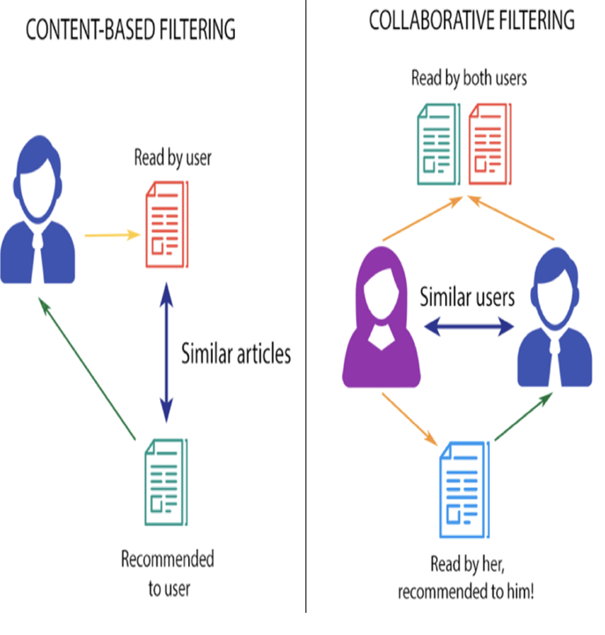
Introduction
What are recommender systems
Why recommender systems
How do recommender systems work
Types of recommender systems
Advantages of recommender systems

Slide 5
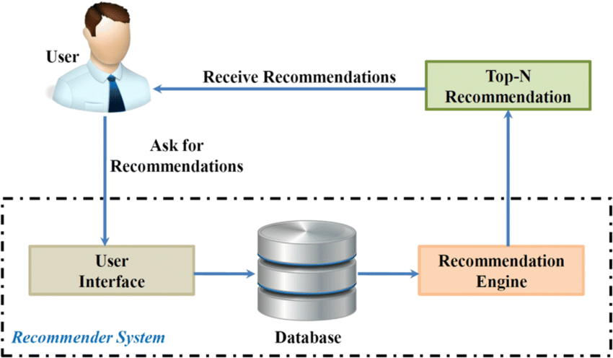
Problem Statement
Construct a recommendation algorithm based on content or collaborative filtering, capable of accurately predicting how a user will rate a movie they have not yet viewed, based on their historical preferences.
This will enable EDSA to recommender new movies to their users.

Slide 6
Project sequence
Model deployment
Recommender system model
EDA
Data processing
Data collection

Slide 7
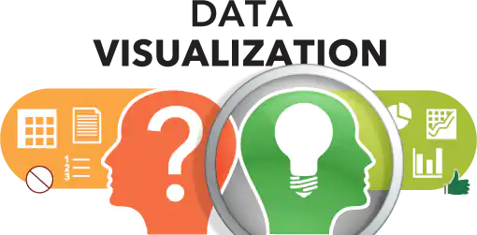

Slide 8
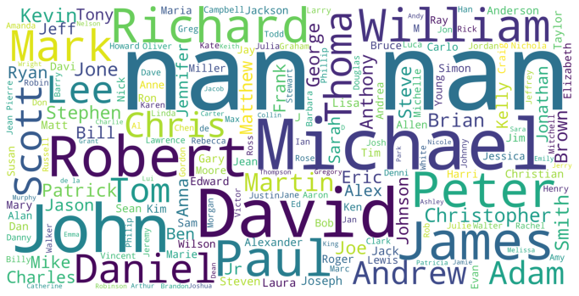
Wordcloud for cast list

Slide 9
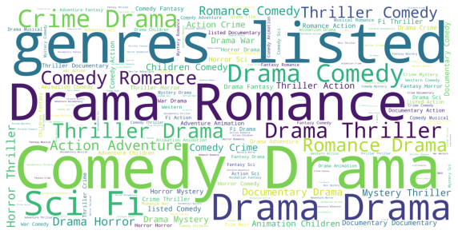
Wordcloud for the genres in the dataset

Slide 10
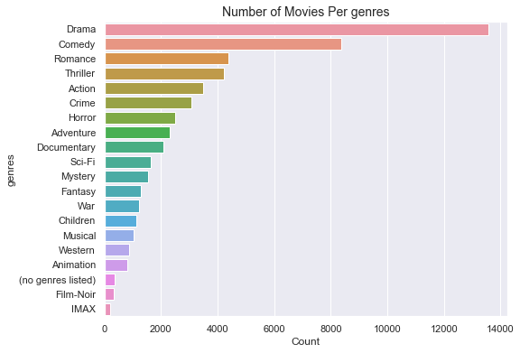

Slide 11
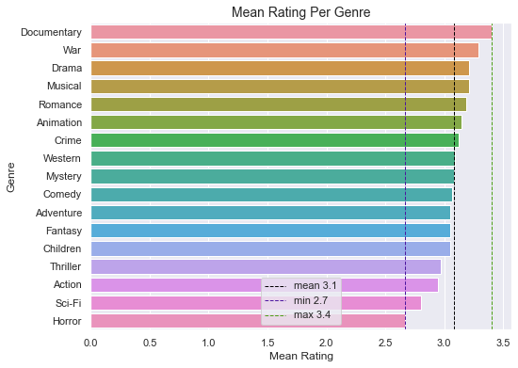

Slide 12
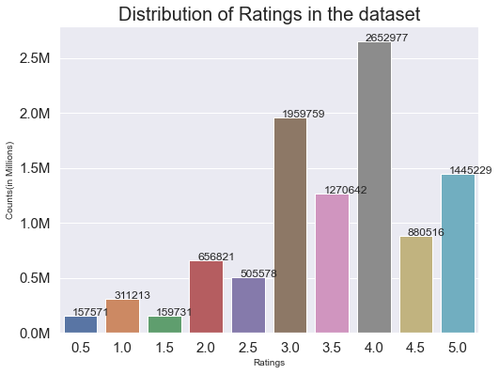

Slide 13
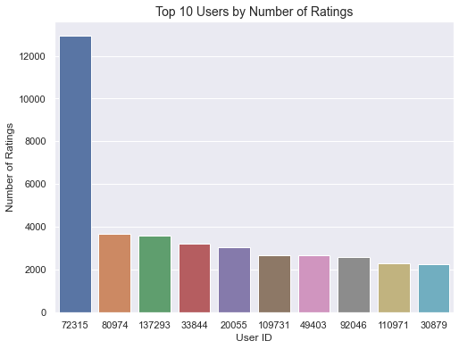

Slide 14
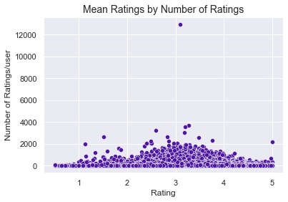

Slide 15
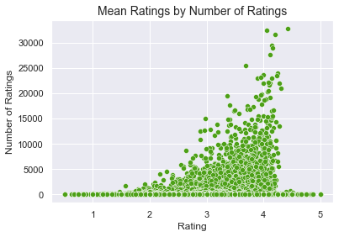

Slide 16
Model building
SVD
Normal predictor
Baseline only
NMF
Slope one
Co-clustering
SVD++

Slide 17
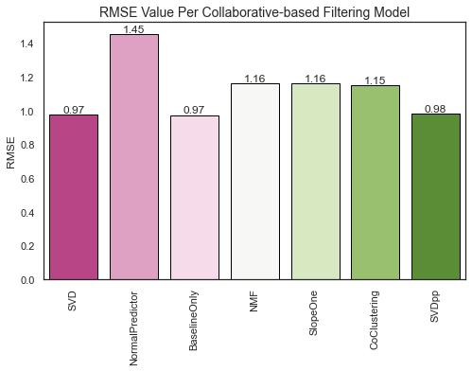
Model Evaluation

Slide 18
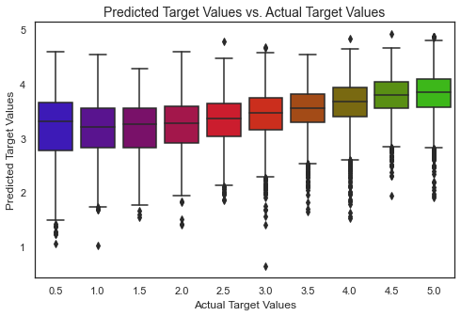

Slide 19
Model deployment

Slide 20
Acknowledgements

Slide 21
References
https://www.sas.com/en_us/insights/big-data/data-visualization.html

Slide 22
Presentation outline
1. Introduction
5. Model Building
2. Problem Statement
6. Model deployment
3. Project sequence
7. References
4. Explanatory Data Analysis
8. Acknowledgements

Slide 23
Project sequence
Model deployment
Recommender system model
EDA
Data processing
Data collection

